Slide 1
Spring Security
EPAM Java training

Slide 2
What is Spring Security?
Spring Security is a framework that focuses on providing both authentication and authorization to Java applications.
Comprehensive and extensible support for both Authentication and Authorization
Protection against attacks like session fixation, clickjacking, cross site request forgery, etc
Servlet API integration
Optional integration with Spring Web MVC

Slide 3
What are Authentication and Authorization?
Authentication
  Authentication is used by a server when the server needs to know exactly who is accessing their information or site.
  In authentication, the user or computer has to prove its identity to the server or client.
  Usually, authentication by a server entails the use of a user name and password.
Authorization
  Authorization is a process by which a server determines if the client has permission to use a resource or access a file.
  Authorization is usually coupled with authentication so that the server has some concept of who the client is that is requesting access.

Slide 4
Spring Security
Xml
or
Annotations

Slide 5
xml example - Configuring web.xml
To integrate Spring Security with a Spring MVC web application, just declares DelegatingFilterProxy in web.xml as a servlet filter to intercept any incoming request.
<!-- Spring Security -->
<filter>
<filter-name>springSecurityFilterChain</filter-name>
<filter-class>org.springframework.web.filter.DelegatingFilterProxy
</filter-class>
</filter>
<filter-mapping>
<filter-name>springSecurityFilterChain</filter-name>
<url-pattern>/*</url-pattern>
</filter-mapping>

Slide 6
xml example - The Security Namespace
Specifying the Security Namespace:
<beans xmlns="http://www.springframework.org/schema/beans"
xmlns:xsi="http://www.w3.org/2001/XMLSchema-instance"
xmlns:context="http://www.springframework.org/schema/context"
xmlns:security="http://www.springframework.org/schema/security"
xsi:schemaLocation="http://www.springframework.org/schema/beans
http://www.springframework.org/schema/beans/spring-beans-3.0.xsd
http://www.springframework.org/schema/context
http://www.springframework.org/schema/context/spring-context-3.0.xsd
http://www.springframework.org/schema/security
http://www.springframework.org/schema/security/spring-security-3.0.xsd">
</beans>

Slide 7
xml example - Enabling Web Security
Web Security enabled via <http> tag:
Identify authentication provider
<http auto-config="true">
<intercept-url pattern="/admin**" access="ROLE_USER" />
</http>
<authentication-manager>
<authentication-provider>
<user-service>
<user name="admin" password="123456" authorities="ROLE_USER" />
</user-service>
</authentication-provider>
</authentication-manager>

Slide 8
xml example - Custom Login Form
login-page=”/login” – The page to display the custom login form
authentication-failure-url=”/login?error” – If authentication failed, forward to page /login?error
logout-success-url=”/login?logout” – If logout successful, forward to view /logout
username-parameter=”username” – The name of the request which contains the “username”. In HTML, this is the name of the input text.
<http auto-config="true" access-denied-page="/error403.jsp">
<intercept-url pattern="/admin**" access="ROLE_USER" />
<intercept-url pattern="/index*" access="ROLE_USER,ROLE_ANONYMOUS"/>
<form-login
login-page="/login"
default-target-url="/welcome"
authentication-failure-url="/login?error"
username-parameter="username"
password-parameter="password" />
<logout logout-success-url="/login?logout" />
<anonymous username="guest" granted-authority="ROLE_ANONYMOUS"/>
<remember-me/>
</http>

Slide 9
xml example - Login Form using database
Use jdbc-user-service to define a query to perform database authentication.
<!-- Select users and user_roles from database -->
<authentication-manager>
<authentication-provider>
<jdbc-user-service data-source-ref="dataSource"
users-by-username-query=
"select username,password, enabled from users where username=?"
authorities-by-username-query=
"select username, role from user_roles where username =? " />
</authentication-provider>
</authentication-manager>

Slide 10
Maven
<dependency>
<groupId>org.springframework.security</groupId>
<artifactId>spring-security-web</artifactId>
<version>3.2.5.RELEASE</version>
</dependency>
<dependency>
<groupId>org.springframework.security</groupId>
<artifactId>spring-security-config</artifactId>
<version>3.2.5.RELEASE</version>
</dependency>

Slide 11
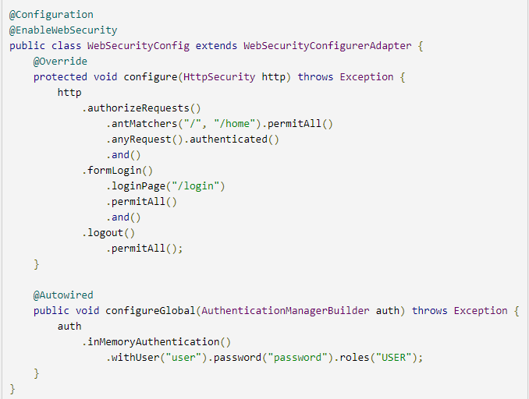
Annotations – enable security

Slide 12
Annotations – enable security
The WebSecurityConfig class is annotated with @EnableWebSecurity to enable Spring Security’s web security support and provide the Spring MVC integration.
The configure(HttpSecurity) method defines which URL paths should be secured and which should not. Specifically, the "/" and "/home" paths are configured to not require any authentication. All other paths must be authenticated.

Slide 13
Annotations – enable security
When a user successfully logs in, they will be redirected to the previously requested page that required authentication.
There is a custom "/login" page specified by loginPage(), and everyone is allowed to view it.
configureGlobal(AuthenticationManagerBuilder) method sets up an in-memory user store with a single user. That user is given a username of "user", a password of "password", and a role of "USER".

Slide 14
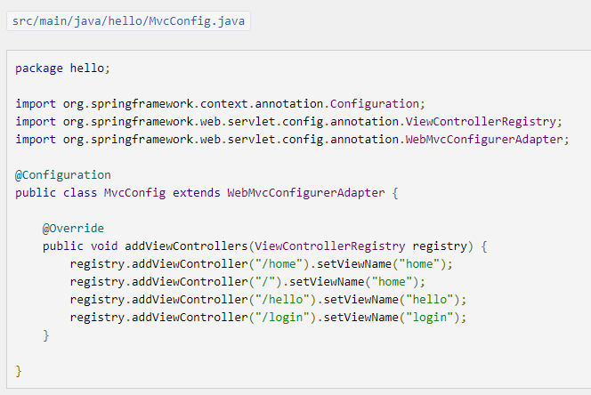
View controllers
You need to configure Spring MVC and set up view controllers to expose the /home, /hello and /login templates.

Slide 15
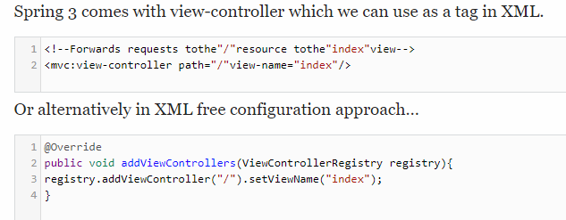
View controllers
It is not very convenient to write a controller method to just re-direct it to a view if you don’t have anything to do in controller.

Slide 16
View controllers
Behind the scenes, mvc:view-controller registers a ParameterizableViewController that selects a view for rendering. In the abovementioned case, when “/” is requested, the index view is rendered.

Slide 17
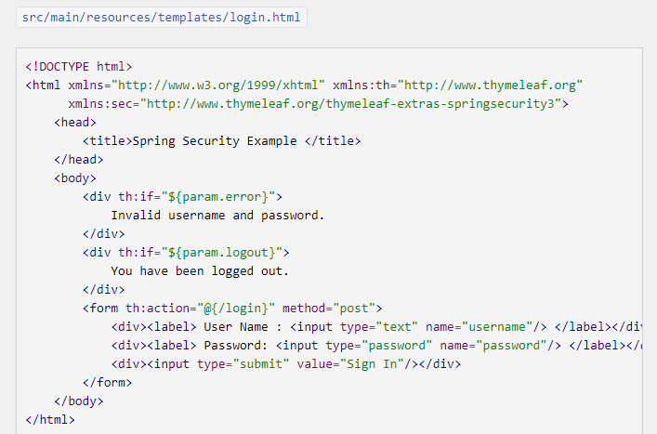
Custom login page
There’s already a view controller for the "login" view, so you only need to create the login view itself:

Slide 18
References
https://spring.io/guides/gs/securing-web/
https://docs.spring.io/spring-security/site/docs/current/reference/html5/#mvc
https://dzone.com/articles/spring-mvc-3-view-controller
https://www.mkyong.com/spring-security/spring-security-hello-world-annotation-example/
http://projects.spring.io/spring-security/
http://www.mkyong.com/tutorials/spring-security-tutorials/

